Slide 1

by Team Zim Professor Zareh Gorjian & Professor Silvia Rigon
Artists
Alex Kim: a.hyun.k@gmail.com
Eric Galindo: Ericgalindo93@yahoo.com
Seif Mohsen: seifmohsen357@gmail.com
Programmers
Lori Kim: kim.lori57@gmail.com
Huy Ly: Huyly960@gmail.com
Stanley Chen: Stan.yt.chen@gmail.com

Slide 2
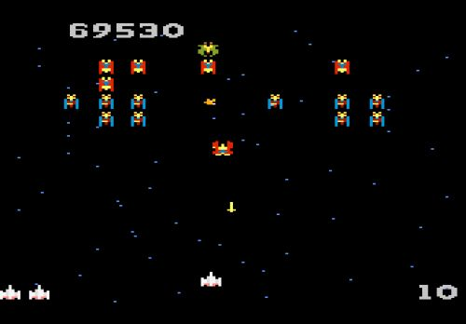
Game Structure
Space shooter
https://www.youtube.com/watch?v=kX0hnOS1QQQ
Outline
1. Rules
2. Characters
3. Gameplay
4. Player stats
5. Dimensions and Frames
6-9. Inspiration
10. First Boss (The Void)
11. Second Boss (Vordo’s Head)
12. Final Boss (Deathship)
13. Goals

Slide 3
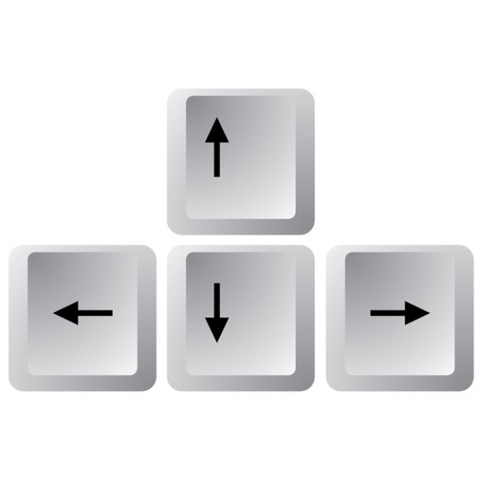


Rules
Player can move left, right, up, and down and to anywhere within the screen.
Player starts with 5 HP(Heart Points) and 10 MP(Missile Points) (MP is optional)
If enemy object is not a boss and gets destroyed by player projectile, enemy object is destroyed and drops HP packs(Restores HP) , MP packs 5+ (MP is optional),and weapon upgrades.
If enemy object is a boss and gets hit by player projectile, boss loses a certain number of health points and is killed if Heart Points reach 0.
Player achieves weapon upgrade when passing over a weapon upgrade object. A weapon upgrade means a higher firing frequency.
Objective: Destroy maximum number of enemy objects and defeat the enemy bosses.

Slide 4
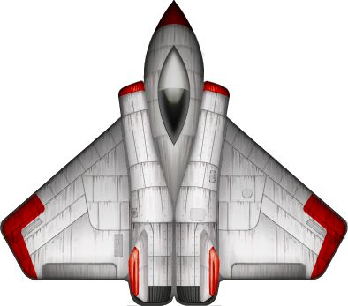
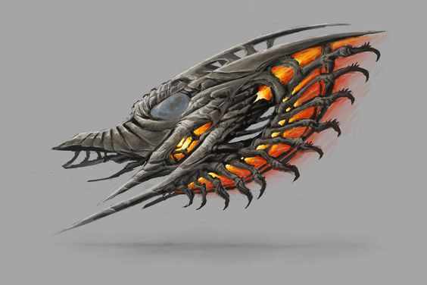
Characters (Player & Enemy)
Main character: player spaceship 5 HP(can be upgraded) 10 MP(can be upgraded) (MP is optional)
Enemy characters: low: 2 HP, medium: 5 HP. (MP is optional)
Enemy spaceship (one shot death, shoots one projectile linearly)
Boss 1 (30 HP, shoots 5 shots radially)
Boss 2 (50 HP, shoots 10 shots radially)
Boss 3 (100 HP, shoots 15 shots radially)
General Missile: 2 DP(Damage Points)
Advanced Missile: 5 DP (Optional)
Tracking Missile: 5 DP (Optional)

Slide 5
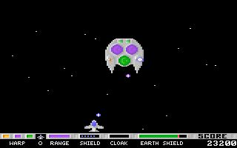
Gameplay
Infinite / level-based gameplay
Enemy objects appear at a gradually higher rate
Boss objects appear at random moments but no two bosses at a time.

Slide 6
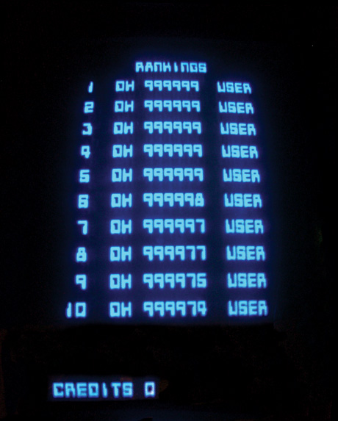
Player Stats
Featured during game
Score calculated from number of enemy objects destroyed by player
Featured after game
Score
Number of bosses killed
Number of enemy objects killed
Firing rate
Level of professionalism

Slide 7
Dimensions and Frames
Background: 1900 x 998px
Main Character Sprite: 100 x 100px
6 frames for left and right half rotation horizontally
Missiles: 50 x 50px
6 frames for speed
Minions: 100 x 100px
6 frames for horizontal rotation

Slide 8
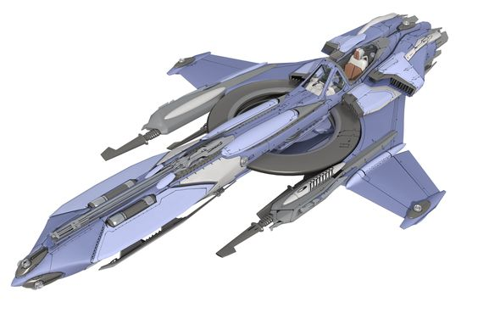
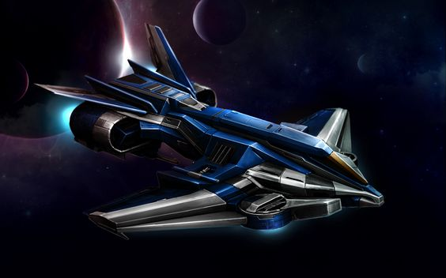
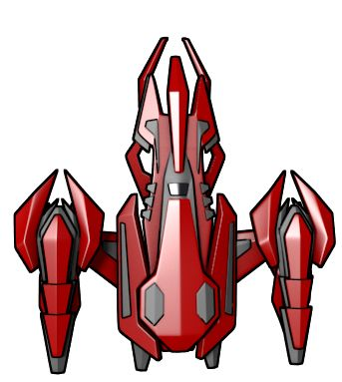
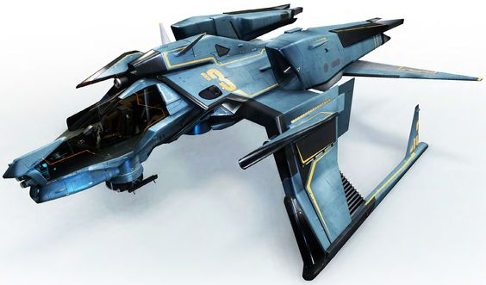
Inspiration for Spaceship(Player)

Slide 9
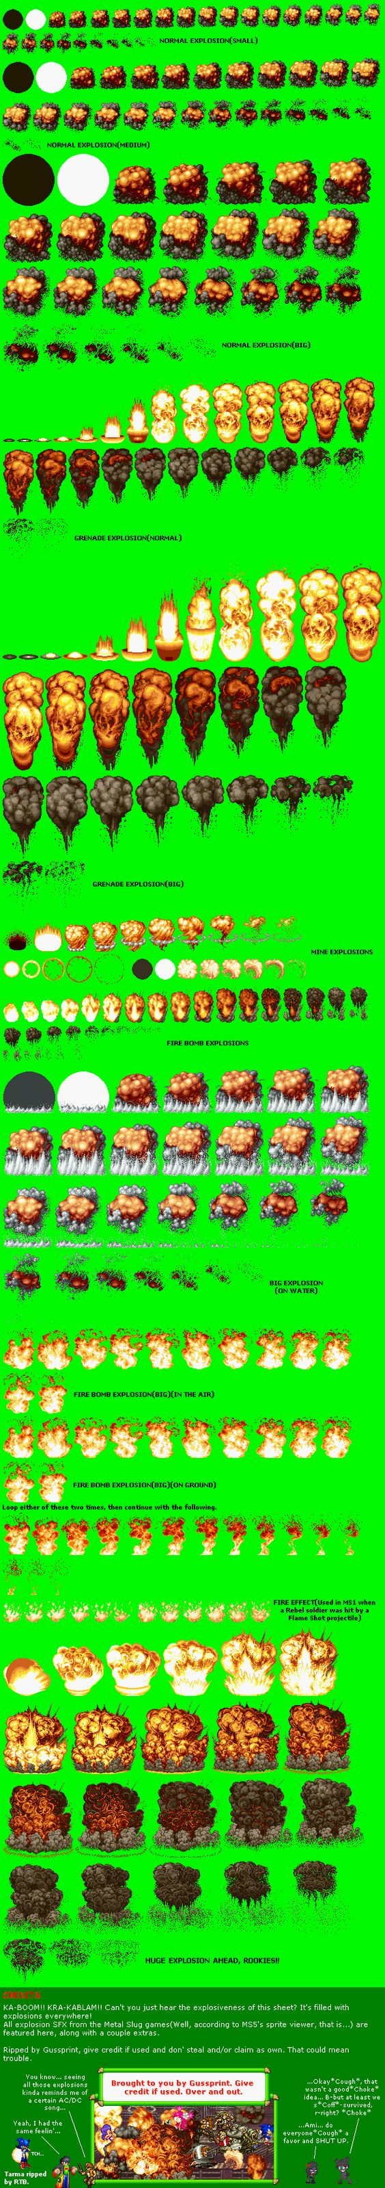
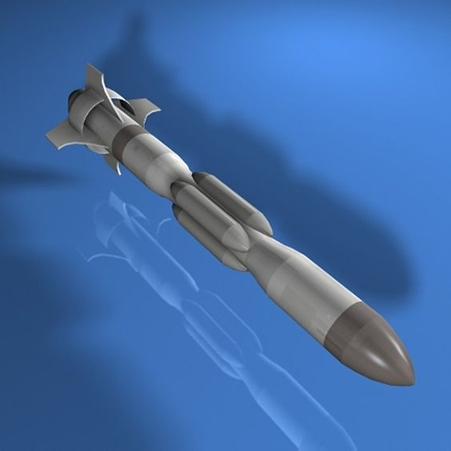
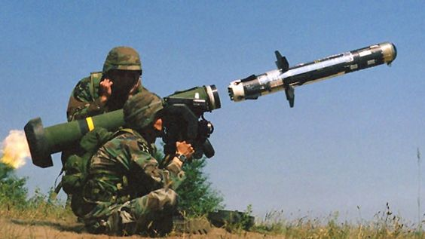
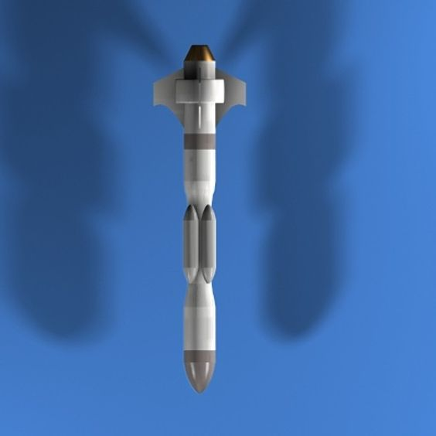
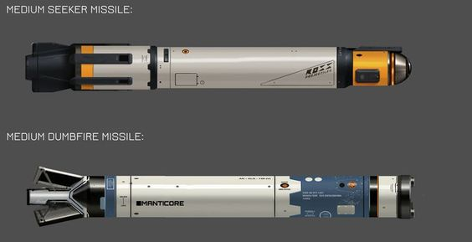
Inspiration: Missiles

Slide 10
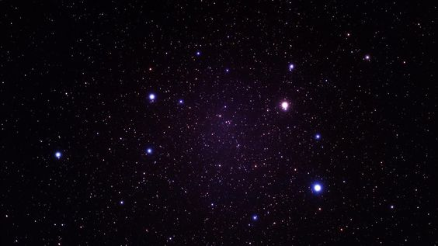
Inspiration BG( Background)

Slide 11
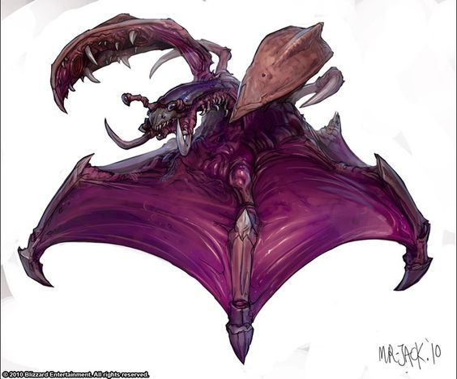
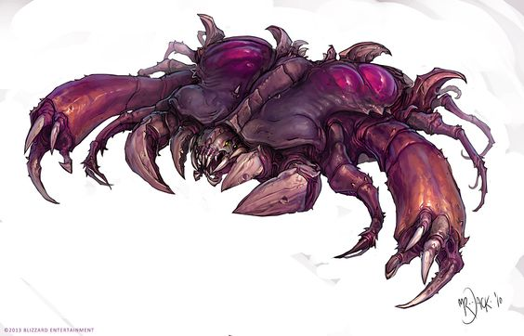
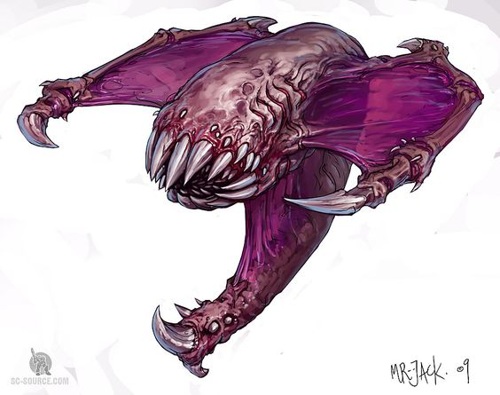
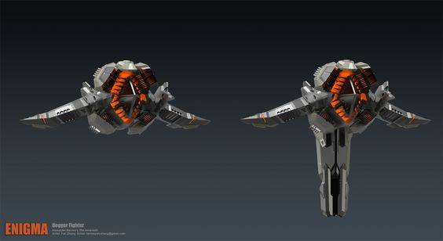
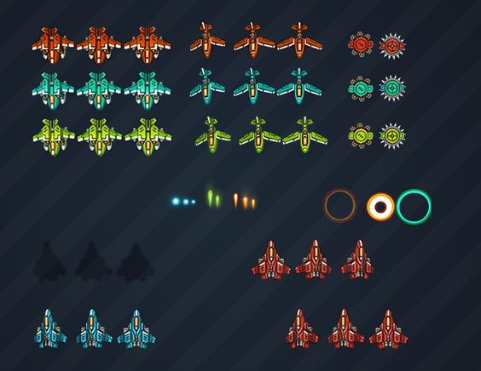
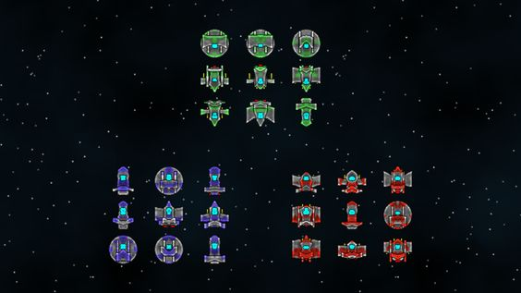
Inspiration for Enemies/Minions

Slide 12
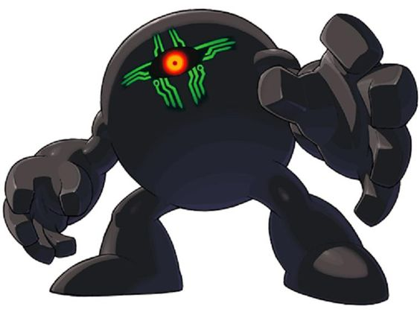
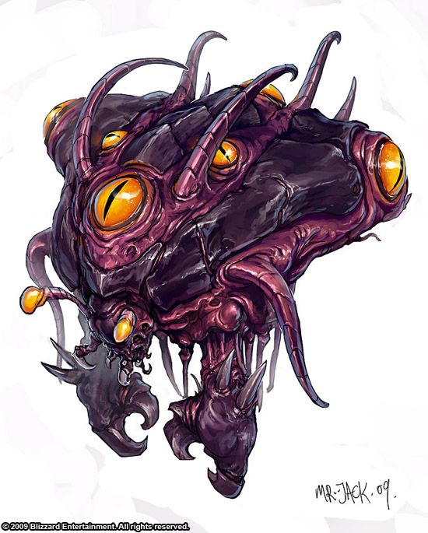
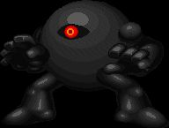
First Boss (The Void)

Slide 13
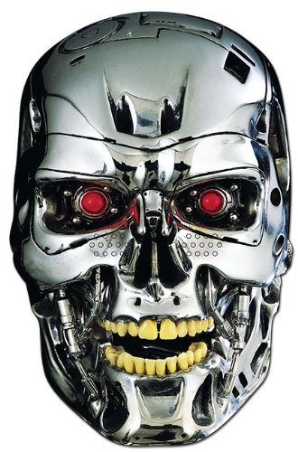
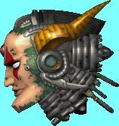

Second Boss (Vordo’s Head)

Slide 14
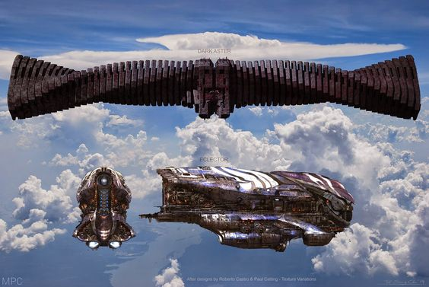
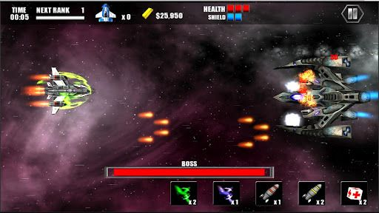
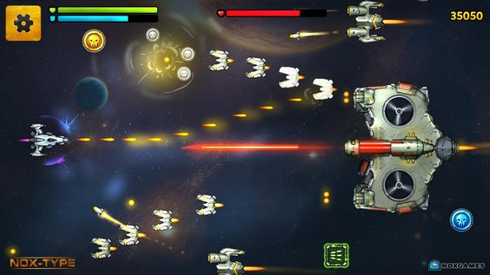
Final Boss (Deathship)

Slide 15
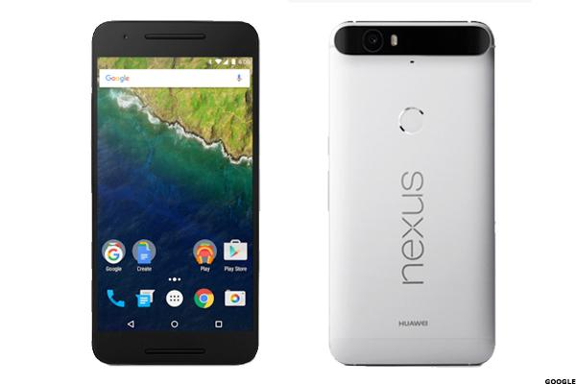
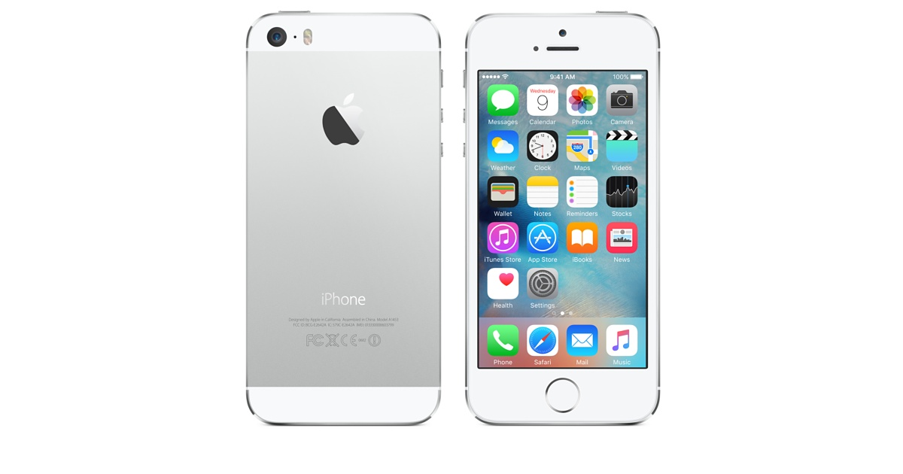

Goals
Collaboration between programmer and artist
Mobile game development (Android & Iphone)

